Slide 1
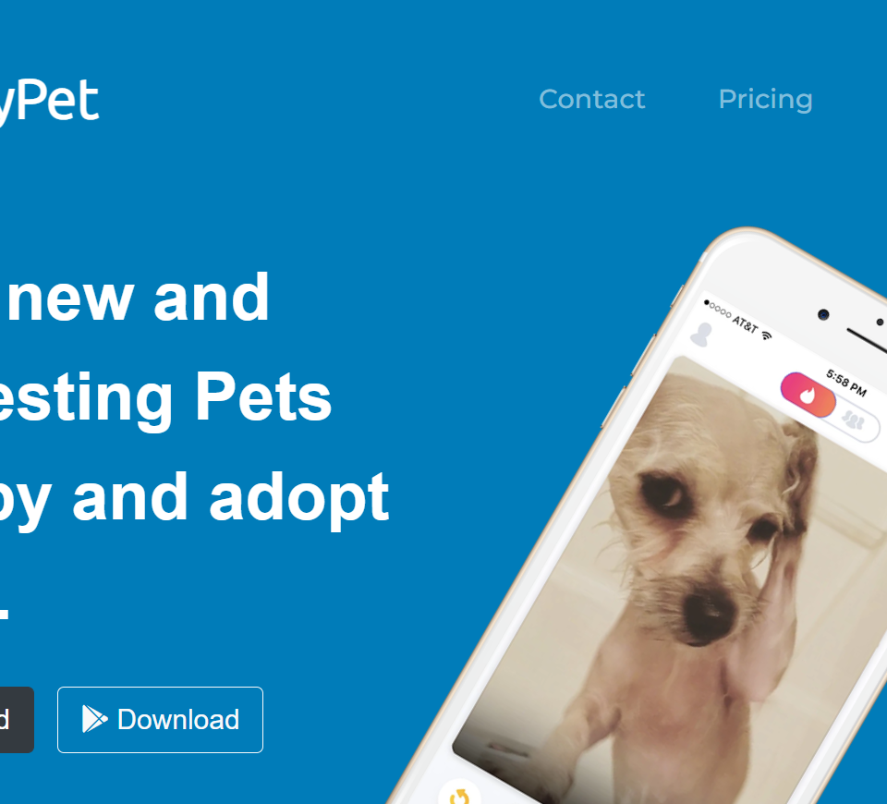

Team Name: Byte Coders
Final Project: FindmyPet-static-website

Slide 2
PROJECT TITLE
Deploying Static website on Cloud Platforms

Slide 3

AGENDA
Team Name and Introduction
What is the Problem Statement?
Tech Stack we are using
Project Overview
Who are the End Users?
The Wow in our solution
Website Presentation

Slide 4

PROBLEM STATEMENT
Deploying Static website on Cloud Platforms

Slide 5

PROJECT OVERVIEW
In this Project we have made a static website using HTML and CSS and Bootstrap for mobile responsiveness
We have deployed the Project on Amazon AWS S3 platform
The name of our website is FindmyPet and the idea of our website is to find pets online

Slide 6

WHO ARE THE END USERS?
The end users in our Project are people who are trying to find Pets and facing difficulties

Slide 7

YOUR SOLUTION AND ITS VALUE PROPOSITION
In our Project we have made a static website using HTML and CSS with which customers can use to contact us or use our website
We have deployed it in AWS S3 so that customers can use our website from all over the world

Slide 8

THE WOW IN YOUR SOLUTION
We have developed an excellent user interface that is responsive as well and users can easily use it mobile phone as well desktop
We have deployed the Project AWS S3 so that customers can quickly access it from servers of AWS

Slide 9
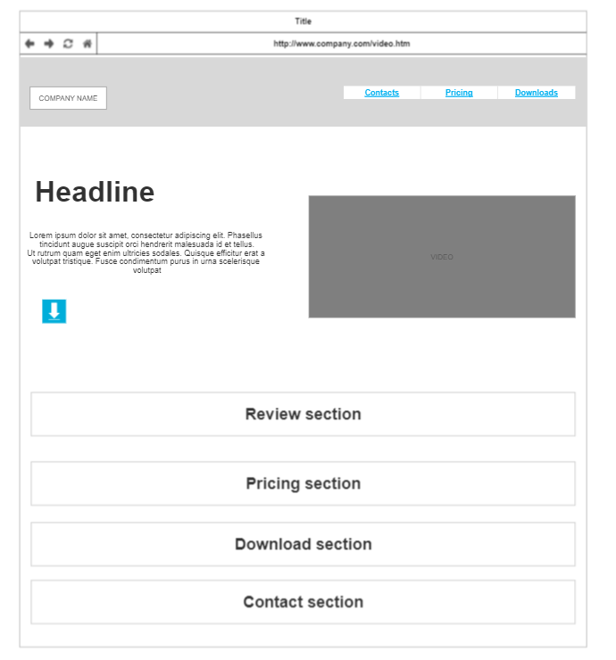
MODELLING

Slide 10
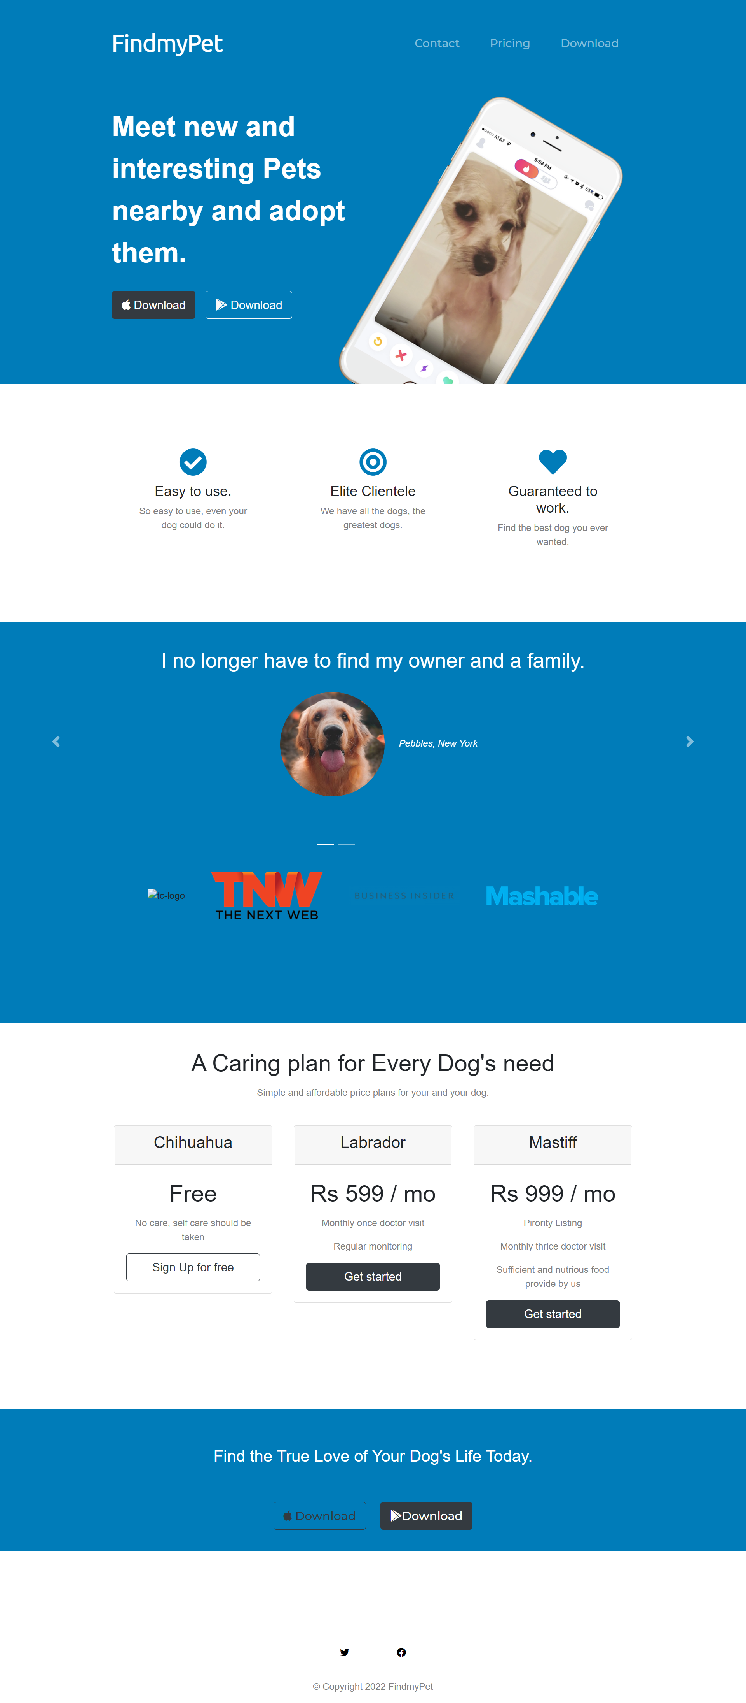
RESULTS
Screenshot of website
Demo Link

Slide 11
MEET OUR TEAM
Names of members
Pritam Panda(Group leader)
Saiteja Poda
Tulluru Deepthi
Madhura Kameswara Sathya
Farzana Firdose
Aditi Yadav
.
.

